Slide 1

StudySauce
Investor presentation
January 2014

Slide 2
No one is taught how to study
The Problem
Students spend decades in school and don’t receive instruction on how to study effectively
Consequently, students develop bad habits that impede their learning ability and overall academic performance. (ex. Common practices like highlighting are detrimental to learning)

Slide 3
We use software to make great studiers
The Solution
Study Sauce automatically detects study behaviors and incorporates leading scientific research to help establish good study habits while eliminating bad study habits.
Our personalized Study Assistant provides students with powerful study tools (detailed study plans, study tutoring, study metrics) to help them make the most of their study time.

Slide 4



Our core team is ready to grow
Stephen Houghton – CEO
McKinsey & Co, Google, 2 start-ups
Captain, US Marine Corps (Counterintelligence)
Stanford MBA, Harvard MPA, SMU BBA in Finance
Brian Cullinan – Engineering
Epic Research & Diagnostic
NAU BS Computer Science
15 years software development
Senior Software Architect
30+ years of software development and management
Can join upon funding
Seed capital will allow us to immediately bring aboard key team members to accelerate growth

Slide 5






We have a suite of study tools around our proprietary Study Detection System
Study incentives
Incentive brokering between students and parents facilitates change of study behavior
Study metrics
Analysis of study sessions allows students to connect effort with outcome
Study assistant
Personalized study plans incorporate a Spaced Repetition System to maximize a student’s retention (premium product)
Study tips
We have collected the disparate scientific findings on study behavior and have consolidated the best insights into our products.
Study Detection System
Study check in
By incentivizing the student to use our software during study sessions, we can teach effective study methods using our SaaS platform. By doing so, we also collect a dataset that has never been collected.

Slide 6
The education market is huge…
Market size estimate
$s, (# of students)
Total available market
Worldwide college students (151M undergrad, 10.8M grad)
K-12 students (750M worldwide)
Serviceable available market
US college students (21M undergrad, 2.7M grad))
Target market
15M traditional college students
US K-12 (50M – not all have access to computers yet)
Online universities and their 7M students
$11B
(912M)
$876M
(73M)
$252M
(21M)
These estimates don’t include potential adjacent markets that need help studying other materials (e.g., corporate education, standardized test prep, bible study, athletic teams, etc.)
Source: National Center for Education Statistics, US Dept of Education

Slide 7







…and untapped by direct competitors
Competitive aspects
Why not a direct competitor
Universities
Most universities offer a basic study skills course, typically in a 1 credit hour course
Offline instruction, limited exposure and feedback, not mandatory
Study skills courses & Learning centers
Blogs/help sites
Disparate sites provide similar content to help students learn study skills
We transform the best tips into actionable steps that help change study behavior
Study tools
Student attention during study time (flashcards, shared notes, etc.); could expand platform
We teach effective study methods, but we want to be a study engagement platform and can offer third party tools
Tutoring
Known paradigm to turn to when students seek help in improving academic performance
We focus on the behavior, not the content

Slide 8
Our first mover advantage will be sustained by our focus on subject matter leadership
Our unfair advantage
First mover advantage
No current direct competitors
Sleepy aspect of education industry should not attract significant attention initially
Growth of unique dataset provides value
Intellectual Property
Provisional patent is already filed – Method and Apparatus for Facilitating Effective Study (serial number 61/923,298)
We plan to cultivate broader IP as we experiment and learn
Subject matter leadership
Currently, there is no direct academic field devoted to studying
Access to students through our app allows fertile testing grounds
We anticipate major R&D investments to sustain thought leadership
First mover advantage coupled with diligent IP will buy us time, but a sustainable competitive advantage will come from maintaining subject matter leadership

Slide 9
Our business model develops in phases
Long term: 2016+
Mid term: 2015
Near term: 2014
B2C
Rapid market testing to reach product-market fit
Begin ramping spend to test sales channels
R&D begins for long term product vision
Major sales and marketing spend to scale
B2B
Pilot program with university
Identify potential second pilot program university
First pilot program becomes customer
Second pilot with another university
Start building sales team and developing pipeline
Rapid expansion with 230K seats sold by Q4 2018
B2C offers a big opportunity and immediate revenue. B2B provides bigger long term value, but will take time to develop.

Slide 10
Our go to market strategy will use multiple channels
Channel
Target customer
Promotion approach
Students
Good students want to improve
Struggling students
Students that want to involve parents (for a variety of reasons)
Social sharing, social ads, deals for students in exchange for logging study hours (e.g., $10 off at Chili’s)
Referral program allows students to benefit from getting friends to join
Parents
Middle to upper class parents with students away at college
Primarily mothers (more responsive demographic)
Social ads on FB, mother groups, advertorials, PR, affiliate programs
Provide ability to help students from a distance
Non-profit universities
Universities seeking to develop their online model
Universities willing to experiment with new concepts
Pilot will target a lesser known program that is willing to run a test
Use pilot data to pursue larger opportunities based on demonstrable improvement in student performance
For profit universities
Online educators seeking to improve retention rate (retention rates are highly correlated with performance; we improve performance)
Show results of pilot programs to illustrate savings to universities for increasing retention rate (customer acquisition costs are soaring)

Slide 11
Revenue ramps up significantly in 2016
Projected revenue breakdown, 2014-2018
$000s
Revenue is split evenly between B2C and B2B, but B2B overtakes in out years
Breakeven is projected for Q3 2015
Key assumptions include:
2.5% customer conversion rate
Pricing of $10/month or $100/year
75% monthly/25% annual customers
5% monthly churn
CPA average of ~$26
230,000 B2B licensed seats at $10/mo by end of 2018
Expenses
1,061
7,646
17,672
27,695
34,513
EBITDA
(589)
(161)
3,402
10,030
14,384
Breakeven projected for Q3 2015

Slide 12
Ed tech is hot and will have exit opportunities
Investment levels are at an all time high
$1.1B invested in ed tech startups in 2012
Huge investment dollars are going into companies trying to revolutionize content delivery (Udemy, Udacity, Khan Academy, UniversityNow, etc.)
"The investing community believes that the Internet is hitting education, that education is having its Internet moment” - Jose Ferreira, founder of the interactive-learning company Knewton
M&A activity is ongoing
Content providers are scrambling to modernize
Grockit acquired by Kaplan – (7/13)
Princeton Review sold its brand (3/12)
Chegg is trying to establish itself as the student ecosystem outside of just text book rentals.
6 acquisitions since 8/10 (including Notehall, a company started in AZ)
Ed tech companies are starting to list on stock exchanges
Chegg – $187.5M IPO (11/13/13)
Instructure (an LMS) is reported to be in the IPO pipeline

Slide 13
Initial findings are very encouraging. We need runway to test other key proof points
Status
Proof points
Findings to date
Identified market gap
Customer interest
Effective initial acquisition channel
User conversion rate
Economical user acquisition price
Customer willingness to pay
Positive user first action
Returning users
Attractive customer conversion rate
Acceptable churn rate
Product-market fit!!!
Accepted problem, no direct competition
Positive customer interviews, great ad CTR (parents 31X > students)
$0.75 to drive a visitor to site using FB ads
25-30% conversion rate for students to join site (outstanding)
New user costs ~$3.25, good channel to rapidly test hypotheses
Early revenue for minimum viable product
20-30% new users enter class information/create goals; more testing
Freemium product released at semester’s end; need testing
~1% conversion rate now; new premium product in development
No refunds to date, but haven’t yet switched to recurring payments
Not there yet

Slide 14
The opportunity
We are raising $250-500K for our seed round using convertible notes with a 20% discount during the next equity round.
We anticipate follow on growth capital investment in Q4 of 2014.
We have accomplished much in 3 months
Built the consumer product
Launched preliminary market testing and incorporated findings
Conducted dozens of customer interviews
Additional capital will enable us to accelerate
Hire key roles (engineers, designer, sales/business development)
Execute B2B pilot program
Drive customers to the service with PR and marketing

Slide 15
APPENDIX

Slide 16
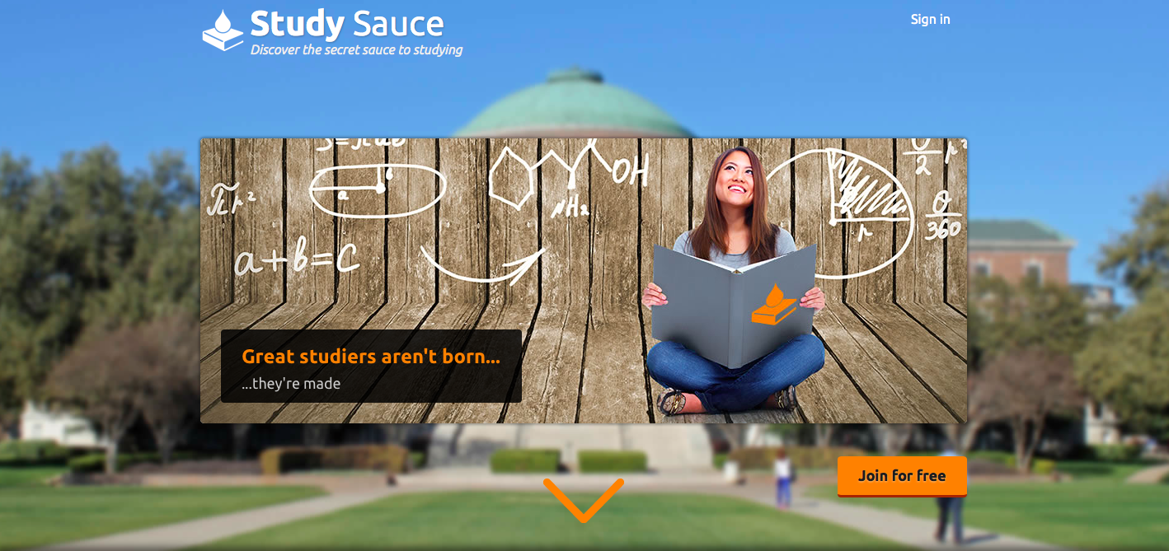
Product screenshot - homepage
Homepage has a clean design with detailed information about Study Sauce below

Slide 17
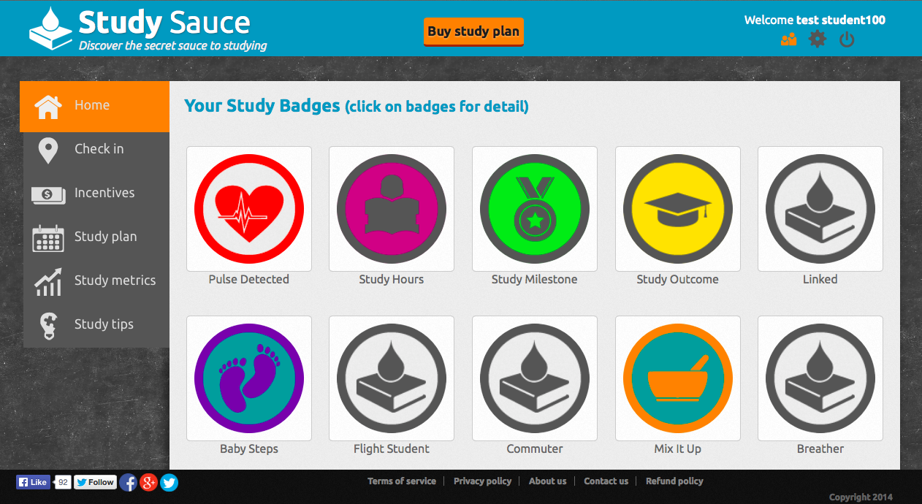
Product screenshot - Home
Following registration, students are instructed in how to use Study Sauce and earn study badges for completing effective study methods.

Slide 18
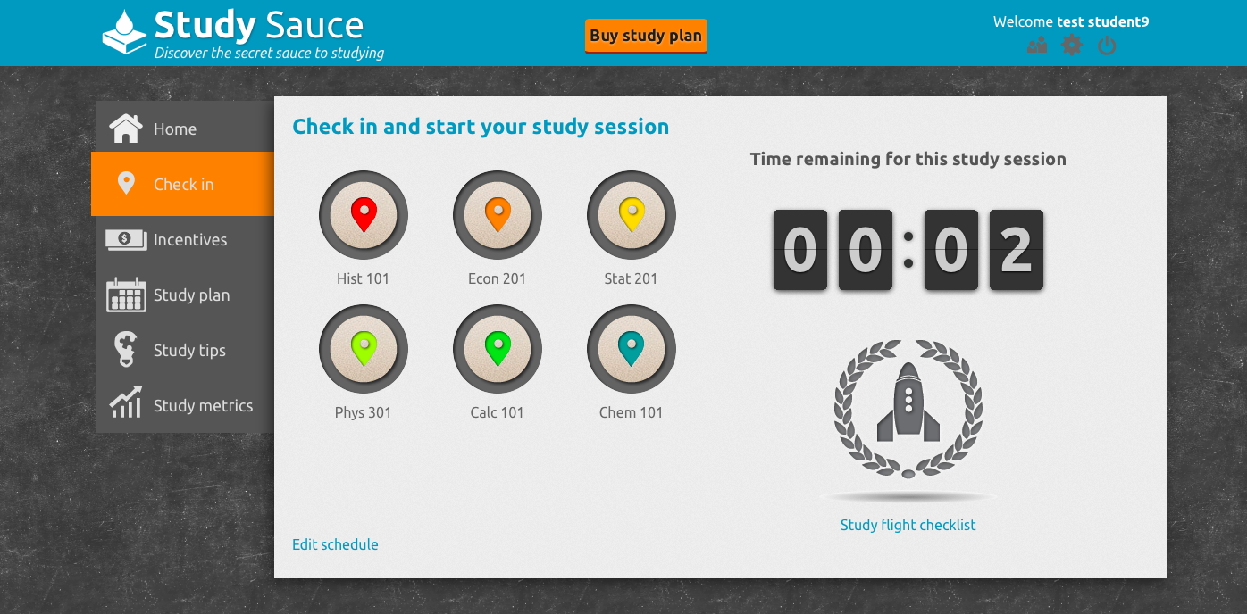
Product screenshot – Check-in
Timer tracks study session and software detects habits and guides the student to optimal behavior (e.g., you should vary your study location to improve retention).
To begin the program, students check in for the class they want to study
“Study Flight checklist” pops up to get student prepared (e.g., turn phone to airplane mode).

Slide 19
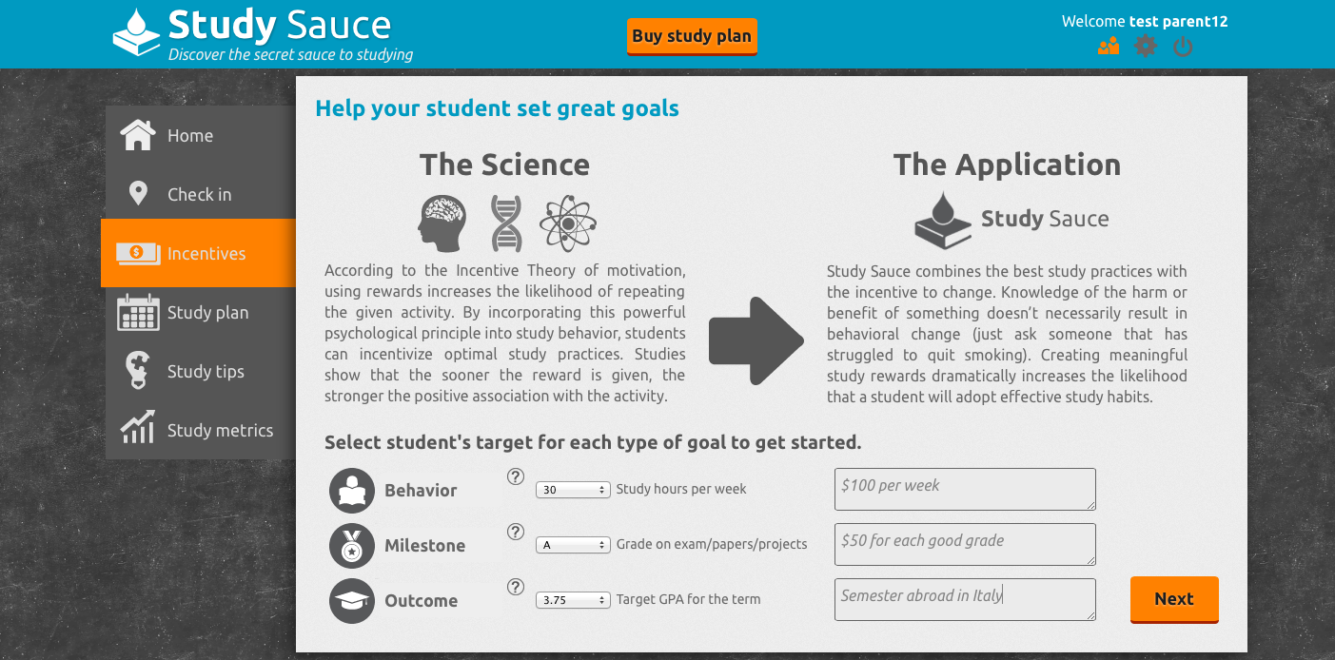
Product screenshot - Incentives
We explain the science behind the Incentive Theory of Motivation and how it is incorporated into Study Sauce
Parents can create goals and rewards for their students. Students can then redeem the rewards based on academic achievements

Slide 20
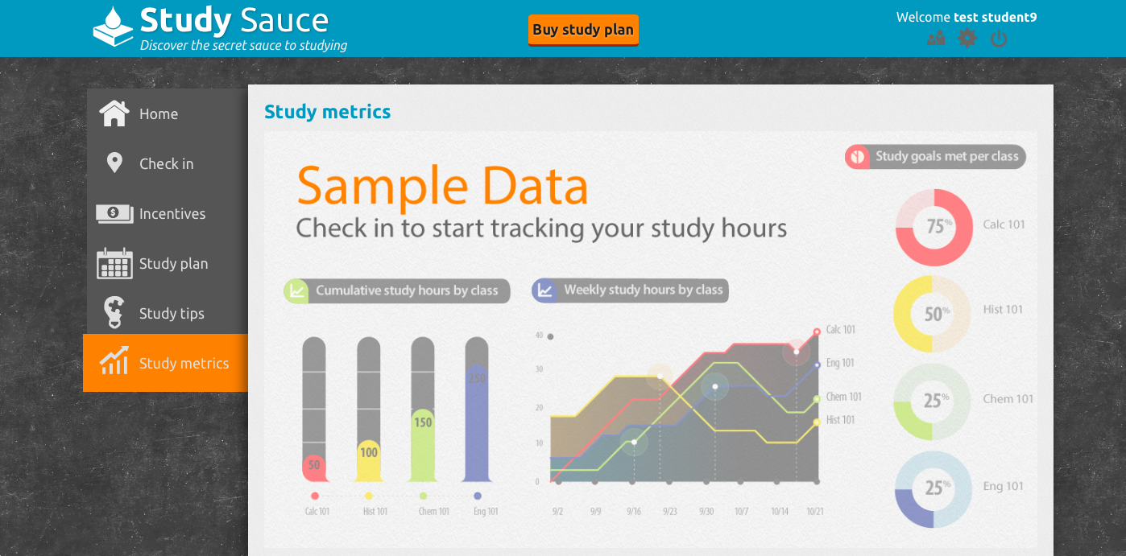
Product screenshot – Study Metrics
We aggregate study metrics to allow the student to see how much work has gone into studying (feature is coming soon, placeholder for now)

Slide 21
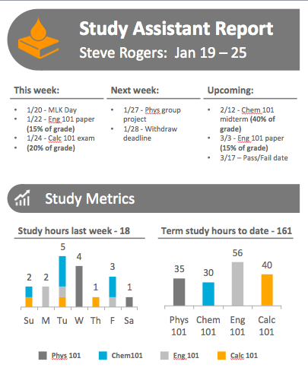
Product screenshot – Study Assistant (1/4)
Delivered weekly
Highlights key dates and grade weighting for students and
Displays previous week and aggregate study time committed

Slide 22
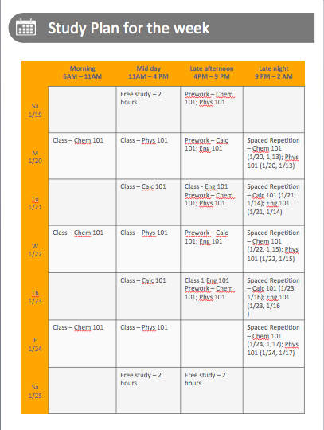
Product screenshot – Study Assistant (2/4)
Study plan uses science of Spaced Repetition (same system used by Jeopardy champions)
Schedule is broken into 5 hour segments of day based on student preferences for ideal study times
Classes and three different types of study sessions are outlined for the student (pre-work, spaced repetition study, free study)

Slide 23
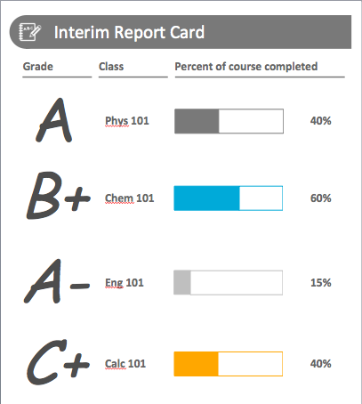
Product screenshot – Study Assistant (3/4)
Grade trajectory for each class provides student with constant reinforcement

Slide 24
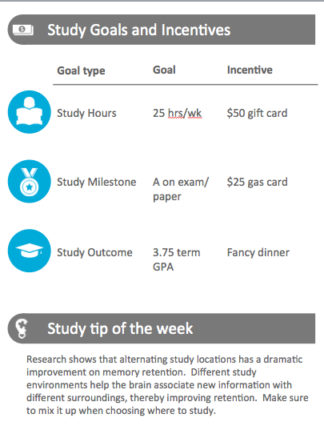
Product screenshot – Study Assistant (4/4)
Study goals and corresponding rewards help motivate student
Personalized study tips are derived from observed study behavior

